Slide 1
Theme 4. Speech coding

Slide 2
Common principles of speech and audio coding
The digitized audio signal in the form of PCM is an almost exact copy, but not a compact form of original recording. Therefore, the conversion of relatively large volumes of audio data, which guarantees the required quality of reproduction of various types of audio information, requires various coding methods that can significantly reduce the redundancy of information for its storage or transmission
The principles of speech coding, the main requirement for which is the intelligibility of the reproduced signal, and audio coding, which guarantees a sufficiently good sound quality of music and voice transmissions, differ significantly from each other.

Slide 3
Common principles of speech and audio coding
An international standard for speech transmission - frequency band from 300 to 3400 Hz. The worldwide telephone network is built based on this standard. The signal should be sampled at a frequency of about 8 kHz, and to obtain normal speech reproduction quality with a uniform quantization scale, it is necessary to use a 13/14-bit quantizer
This linear quantization is necessary because the levels of analog speech signals can vary in the range of 60 dB. But since the perception of signals by human hearing organs is proportional to the logarithm of the signal level, it is advisable to quantize high-level signals more roughly, and low-level signals more accurately. By applying non-linear quantization using a logarithmic law, eight bits per sample can be dispensed with, while maintaining almost the same transmission quality. In this case, the A-Law and μ-Law ratios corresponding to this scale are used. 13-bit A-Law quantization is adopted in Europe, and 14-bit μ-Law quantization is adopted in America and Japan. Resulted bit rate is 64 kbps
Compared to more efficient methods of compressing speech information, these methods of coding are maximally insensitive to errors in the channel with a sufficiently high quality of reconstruction. Therefore, these algorithms are recommended for most digital speech transmission systems as a methods of preliminary analog-to-digital conversion.

Slide 4
Common principles of speech and audio coding
When transmitting speech in digital form, each type of signals with the same duration and the same quality, requires a different number of bits for encoding and transmission. Therefore, the transmission rate of different types of signal can also be different, which leads to the use of variable rate codecs. At the heart of the variable rate speech codec is an input signal classifier that determines the type of its information and sets the coding method and bitrate.
The simplest speech signal classifier is the Voice Activity Detector (VAD), which detects active speech and pauses in the input signal. In this case, signal fragments classified as active speech are encoded by any of the known algorithms (usually based on the ADPCM method) with a base bitrate 4–8 kbit/s. Fragments classified as pauses are encoded and transmitted at a low bitrate (about 0.1 - 0.2 kbps), or not transmitted at all. This strategy allows optimizing the encoding rate up to 2-4 kbps with sufficient quality of the synthesized speech.
The vocoder introduces additional delay - buffer for signal accumulation and the statistics of subsequent samples (algorithmic delay) and algorithmic transformations of the speech signal (computational delay).

Slide 5
Common principles of speech and audio coding
In silence parts of the speech of the active participant in the conversation, the listeners' hardware can simply turn off the sound playback, but it creates "dead silence" which could be disturbing or uncomfortable. This effect can be avoided by using a Comfort Noise Generator (CNG), whose parameters can be transmitted during pauses.
In order to synthesize speech at the receiving end of a communication system, we need audio frequency generator with rich spectrum, a white noise generator, a set of formant filters (their number is small, since there are few vowels, and each of them is quite well defined by two formants), and modulating scheme. With such set of equipment at the receiving end,we can transmit not the speech signal, but only commands that control the process of speech synthesis. Thus, the practical task is to find a way to generate the necessary commands.
Bitrate which is provided by the narrowband codecs used today lies in the range of 1.2 - 64 kbps. The quality of the reproduced speech directly depends on this parameter.

Slide 6
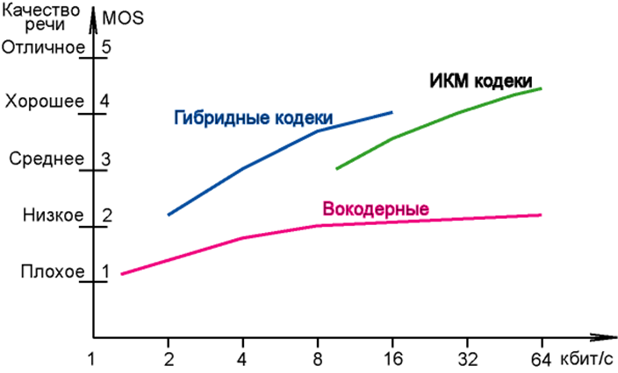
Mean Opinion Score (MOS)
Distortions are assessed by questioning different groups of people on a five-point scale with MOS (Mean Opinion Score) units of subjective assessment. Experts are presented with different sound fragments for listening.
The scores are interpreted as follows:
4-5 - high quality; similar to the quality of speech transmission in relatively broadband communication channels;
3.5-4 - sufficient quality; similar to the quality of speech transmitted using the ADPCM codec at a rate of 32 kbps; this quality is usually provided in most telephone conversations;
3-3.5 - the quality of speech is still satisfactory, but its deterioration is clearly noticeable by ear;
2.5-3 - speech is legible, but requires concentration of attention for understanding; this quality is usually provided in communication systems for special applications (for example, in the military).
With existing technologies, a sufficiently high quality of speech reproduction cannot be provided at speeds less than 5 kbps
Speech quality
Perfect
PCM codecs
Good
Hybrid codecs
Average
Poor
Vocoder codecs
Bad
kbps

Slide 7
Common coding methods
PCM | Standard telephony method, typically 64 kbps
ADPCM | 40, 32, 24, 16 kbps, using a combination of adaptive quantization and adaptive prediction
Vocoders | Compact description of the voice spectrum in several frequency ranges, including tone extraction
Adaptive band coding | 16.8 kbps, speech is divided into frequency bands, and each is encoded according to hearing properties and spectrum prediction
Multipulse Linear Prediction Coding | 8, 4 kbps, the required number of pulses is used to optimize the information about excitation of speech segments, linear segment prediction
Linear Prediction Coding with stochastic excitation | 8 - 2 kbps, the encoder stores a set of candidates for excitation, each consists of a stochastic pulse sequence, the best one is selected

Slide 8
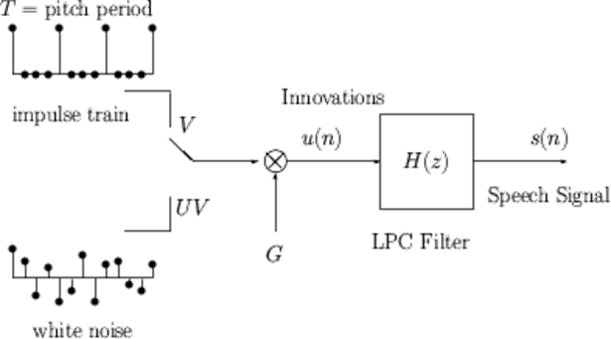
Linear Prediction Coding (LPC)
Many modern audio codecs are based on linear predictive coding (LPC)
A digital voice signal is the output of a digital LPC filter, which receives either pulse trains or white noise patches as input.
Relationship between physical and mathematical models:
Physical model | Mathematical model
vocal tract | H(z) (LPC filter)
air | u(n) (updates)
vibrations of the vocal cords | V (voiced sound)
period of vibrations | T (fundamental pitch period)
unvoiced sounds | UV (unvoiced sound)
air volume | G (gain)

Slide 9
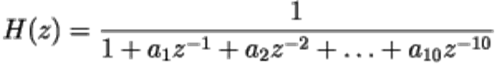
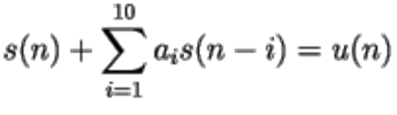
Linear Prediction Coding (LPC)
LPC filter is defined by
which is equivalent to the following filter input and output connection:
LPC model defined as vector
Vector A changes approximately every 20 ms, which corresponds to 160 samples at a sampling rate of 8 kHz
The digital voice signal is divided into 20 ms frames
160 samples of the signal S are compactly represented by 13 values of the vector A
Perception features:
For voiced sounds - pulse shift (phase insensitivity)
For unvoiced sounds - different noise sequences are used
LPC synthesis: obtaining S from A (filtration)
LPC analysis: evaluation of A from S

Slide 10
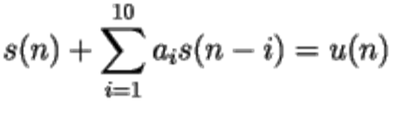
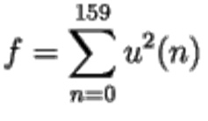
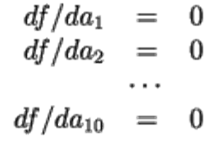
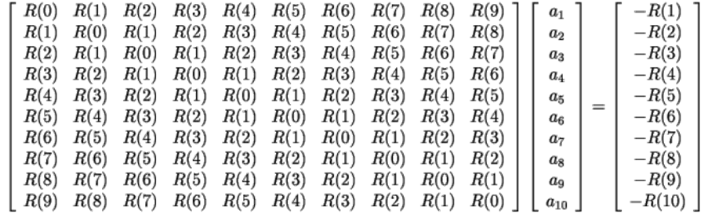
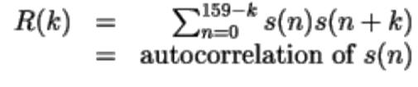
LPC analysis
Consider one frame of a voice signal: S = (s(0), s(1), …, s(159))
The signal s(n) is related to the update u(n) by the linear equation:
The ten LPC parameters (a₁, a₂, ..., a₁₀) are chosen to minimize the update energy:
The standard approach - the derivatives of f to a_{i} are equal to zero:
Thus, we get 10 linear equations with 10 variables:

Slide 11
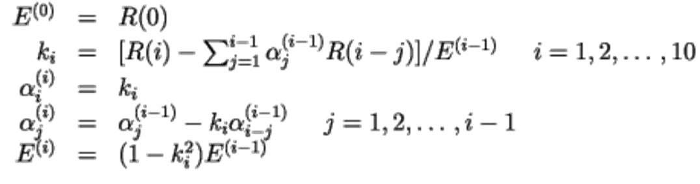

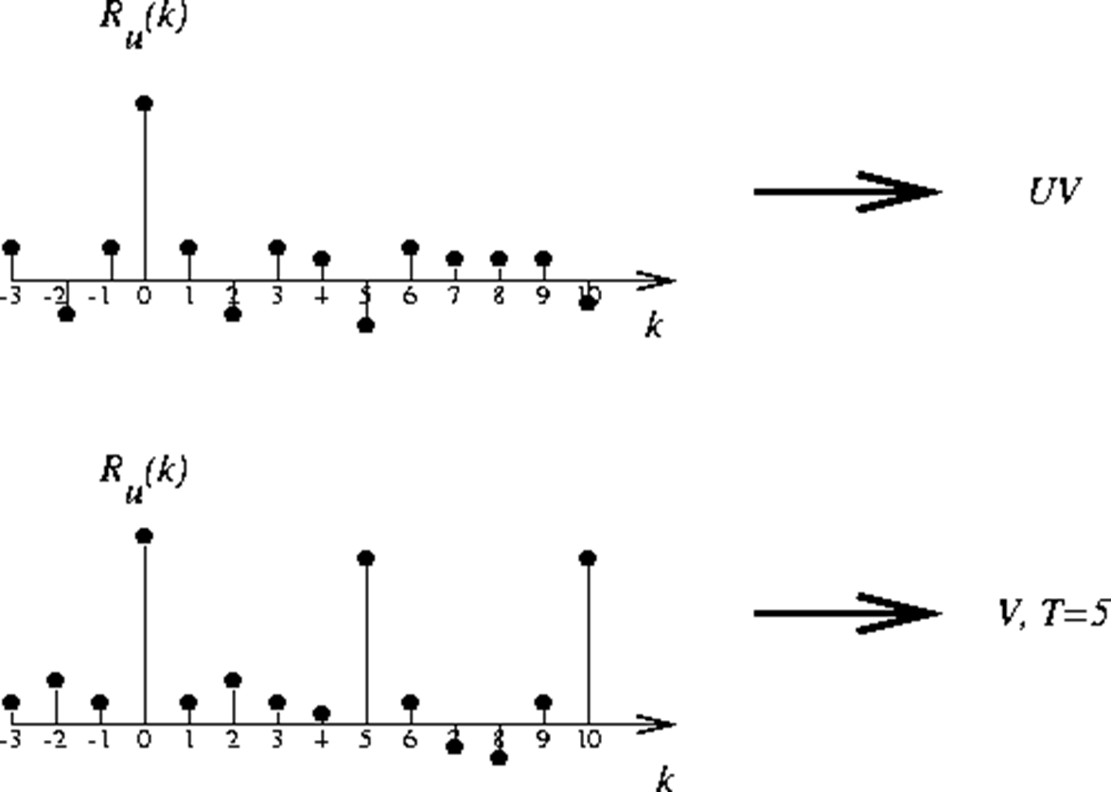
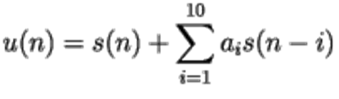
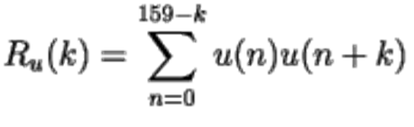
LPC analysis
The resulting system of equations can be solved in the following ways:
Gauss method
any method of matrix inversion
Levinson-Durbin recursion:
The equations are solved for i = 1, 2, …, 10, and then
To obtain the remaining three parameters (V/UV, G, T) the equation for updates is solved:
Then the autocorrelation u(n) is calculated:
Then, based on the autocorrelation, a decision is made about the type of sound (voiced or unvoiced)

Slide 12
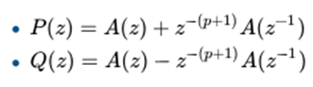
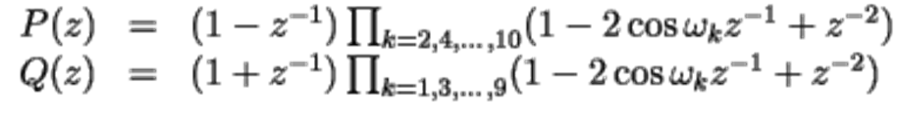




Linear Spectrum Pairs (LSP)
The LPC coefficients are represented in terms of linear spectral pairs LSP (line spectrum pair)
LSPs are mathematically equivalent to LPC coefficients but are better suited for the quantization procedure
LSPs are calculated as follows:
Factorization of these equations gives:
- LSP parameters
LSP parameters are ordered and limited:
They are more frame-to-frame correlated than LPC coefficients.

Slide 13
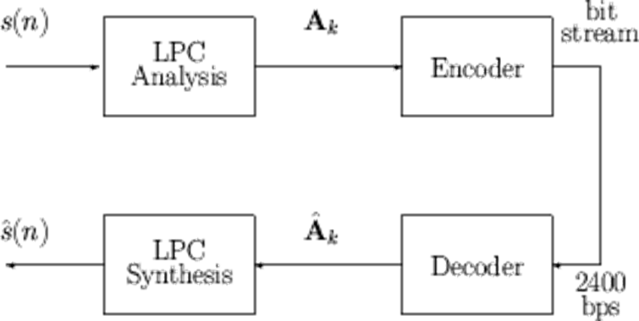
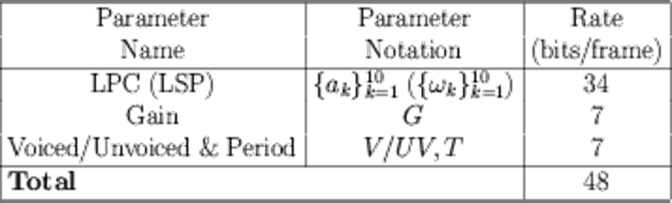
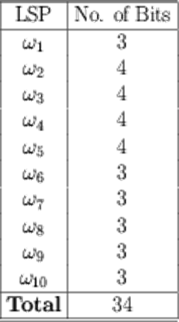
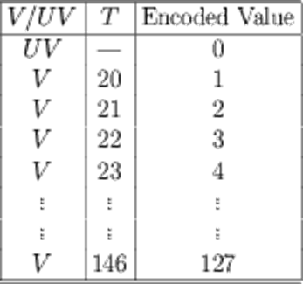
2,4 kbps LPC vocoder
The frame size is 20 ms (50 frames per second). 2400 bps corresponds to 48 bits per frame
A 7-bit non-uniform scalar quantizer is used for gain G
For voiced speech, T values are set in the range from 20 to 146
V/UV, T are encoded jointly

Slide 14
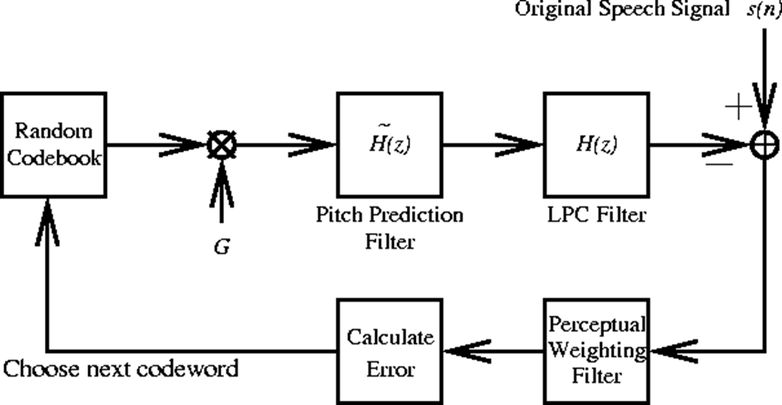
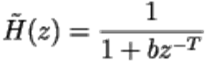
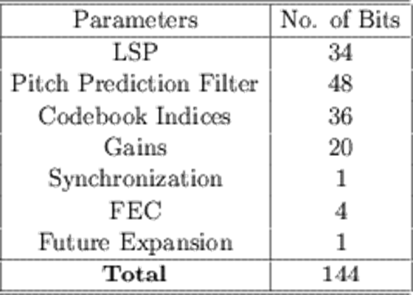
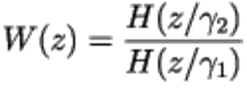

4,8 kbps CELP vocoder
CELP - Code-Exсited Linear Prediction
The coding principles are similar to LPC, except:
frame size - 30 ms (240 samples)
u(n) are encoded directly
more bits are used, more complex calculations
a pitch prediction filter is used
vector quantization is used
Pitch prediction filter:
Perceptual weighting filter:
Each frame is divided into 4 subframes. In each subframe, the codebook contains 512 codevectors
The gain is transmitted in 5 bits in each subframe
LSP parameters are transmitted in 34 bits similar to LPC vocoder
At 30 ms per frame, 4.8 kbps corresponds to 144 bits per frame

